Slide 1
Students’ Education Guide
By Arrows of Artemis

Slide 2

Team Members
Aashin Siby
Abel Saji George
Akhil G Nair
Arun S John

Slide 3
CONTENTS
Statement
Introduction
Working Principle
Result
Conclusion

Slide 4
Statement
College students juggle many problems
These include finding an internship or a job, organizing their life around their schoolwork, and navigating student loan debt.
The website made by our team can help students organize their assignments, set deadlines, and help them keep track of their grades.

Slide 5
Introduction
We have seen many educational apps which are useful for the students such as Byju’s App, KTU Trio, etc.
These apps/websites are becoming so popular nowadays especially in this COVID 19 pandemic situation by making the classes online.
But the major problem the students are facing is that the students can’t find their other academic activities like to find an internship, workshops, and other mechanism to keep their track of their academic career.
This website helps to find their opportunities to keep track of their studies as well as of their other academic activities.

Slide 6
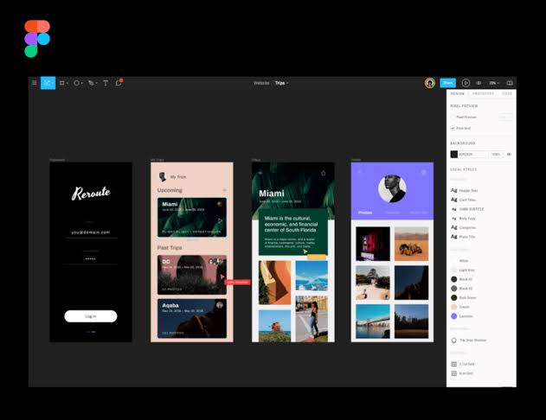
Working
Here, we are creating a prototype of the app using Figma.
The web contains various branch that we can select.
In each course, there is a catalog for lecture videos, online courses, also contains section to find the available internships, workshops, etc..
This makes a student comfortable because he/she can find everything they needed for their respective category and keep track of their respective academic career.

Slide 7
For example, suppose we want to participate in an internship for Python Programming.
So first of all, we select B.Tech course and we select Computer Science as the branch. Then in the internship section, we search in this case, Python Programming. So as a result, we will get every available internships according to our topic.
In the same way, we can find the lecture videos, and this can also act as our project guide.

Slide 8
Result
The hands-on, interactive educational website will be ready for use.

Slide 9
Conclusion
It works like an all in one application.
This will help students improve their college experience.

Slide 10
THANK YOU }

